Slide 1
Start the app
Select source dataset
Upload a gpkg
Use demo dataset
Select attributes that describe:
Linear disturbance industries
Linear disturbance types
Areal disturbance industries
Areal disturbance types
Select buffer size
Use custom buffers
Select overall buffers on:
Set linear buffer size (m)
Set areal buffer size (m)
Set minimum intact patch size (km²)
Include mining claims
Yes
No
Set mine claims buffer size (m)
Include fires
Yes
No
Set minimum fire size to include
Generate intactness map
Save layers in geopackage

Slide 2
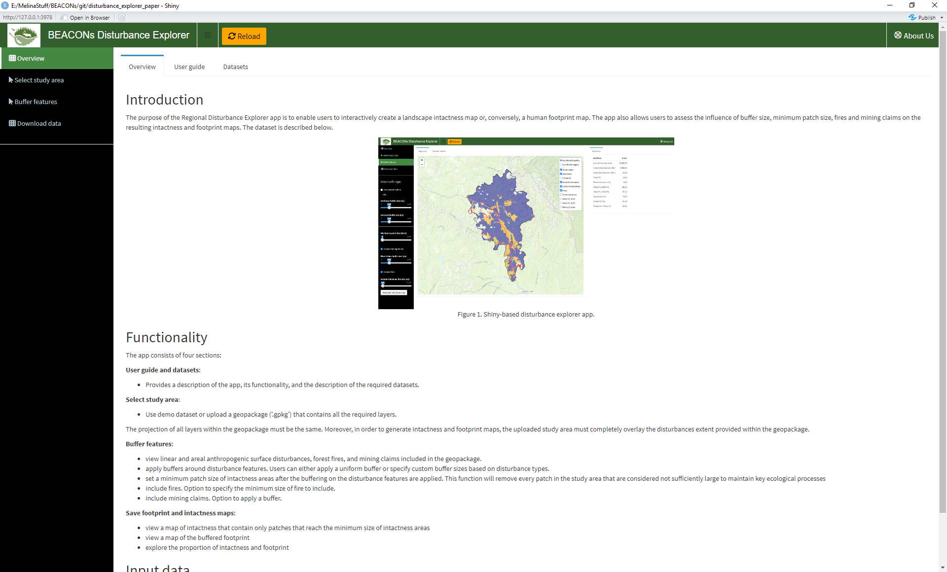

Slide 3
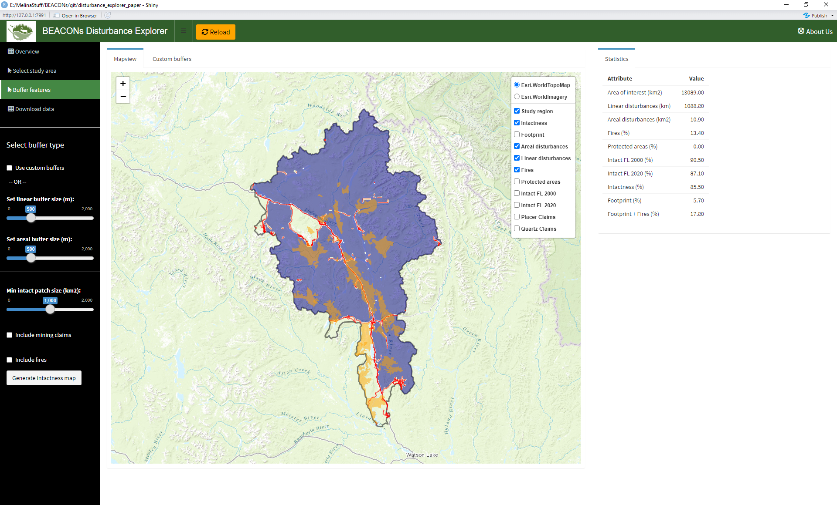

Slide 4
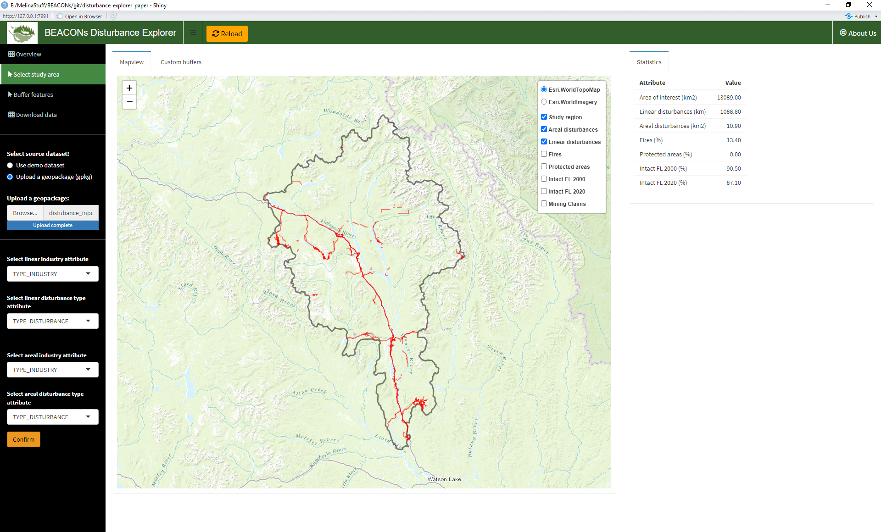

Slide 5
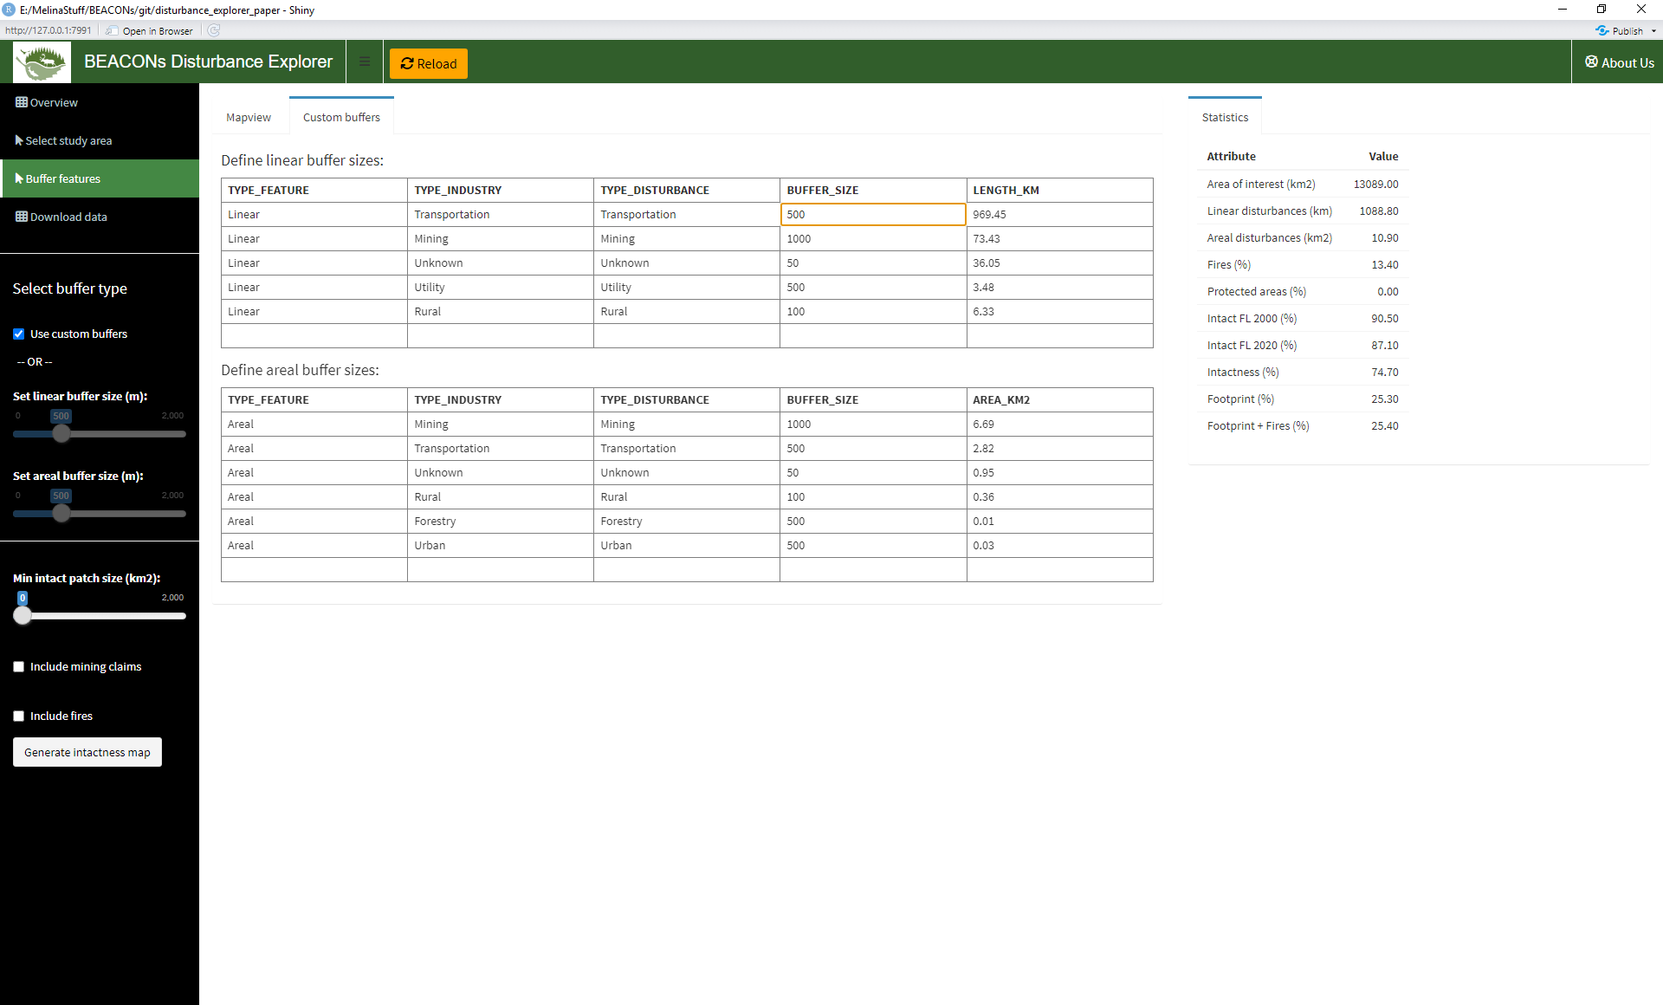

Slide 6
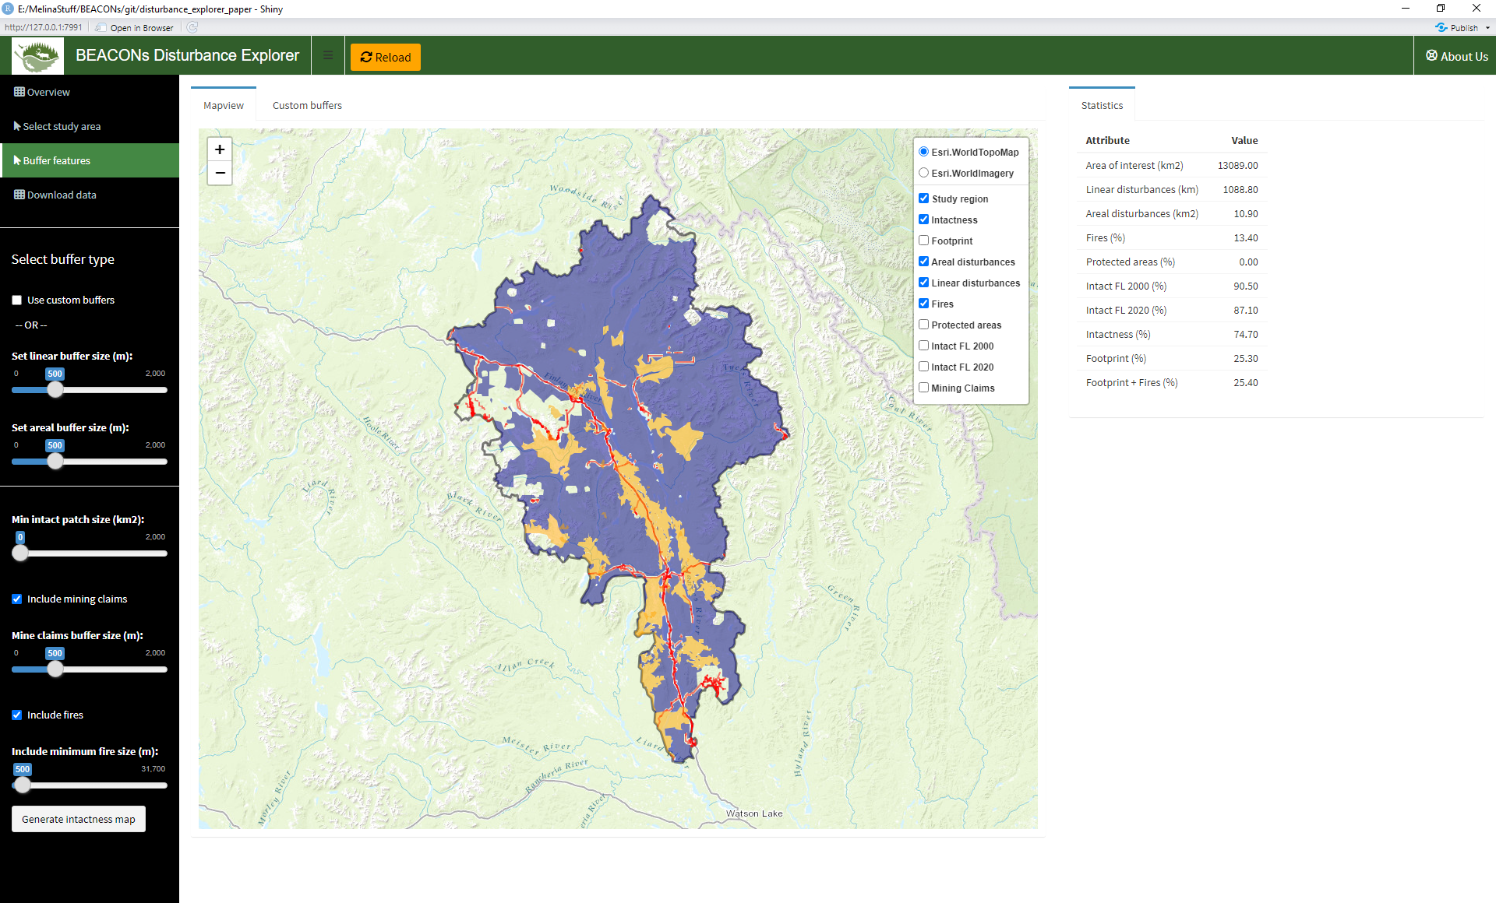

Slide 9
